Slide 1
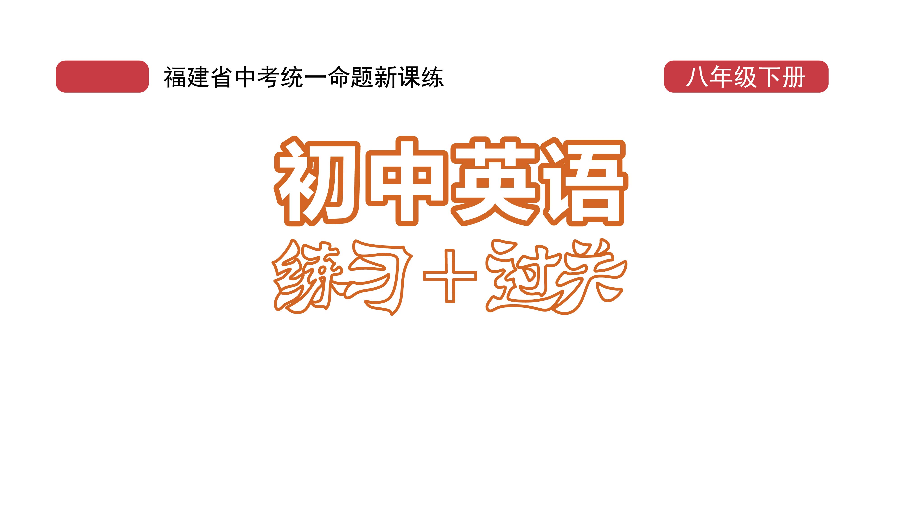
课时练习
模块七 第二章 第三节

Slide 2
一、翻译下列词组。
1. 第一次 ____________________________
2. 餐桌礼仪 _________________________
3. 坐在桌子旁边 ____________________________
4. 以……开始 ____________________________
5. 吃光 ____________________________
(for) the first time
table manners
sit down at the table
start/begin with …
eat up

Slide 3
一、翻译下列词组。
6. 为……干杯 ____________________________
7. 举杯 _________________________
8. 只喝一小口 ____________________________
9. 喝太多 ____________________________
10. 用……吃 ______________________________
drink to …
raise one’s cup/glass
take only a little
drink too much
eat with …

Slide 4
一、翻译下列词组。
11. 用……做…… ____________________________
12. 不需要…… _________________________
13. 指着 ____________________________
14. 一……就…… ____________________________
use … to do …
there’s no need for …
point at
as soon as …

Slide 5
二、用括号内所给单词的适当形式填空， 每空一词。
1. The use of serving______________ (chopstick) is becoming more and more popular in big cities such as Beijing and Shanghai.
2. Please walk as________(quiet) as possible because the students are having a test right now.
chopsticks
quietly

Slide 6
二、用括号内所给单词的适当形式填空， 每空一词。
3. Sloths(树懒) are_________(friend) animals, but sometimes they can be very dangerous.
4. Have you finished_________watch) the film My country， My Parents?
5. When I gave a speech in public for the_____(one) time, I was very nervous.
friendly
watching
first

Slide 7
三、情景交际。
1. 你想知道对方对西餐礼仪了解多少， 可以这样问：
How much do you _______________________________?
2. 你想提醒爸爸不要酒后驾车， 可以这样说：
Remember________________________________.
know about western table manners
not to drive after drinking

Slide 8
三、情景交际。
3. 你想跟对方确认你是否可以在此处拍照， 可以这样问：
Could you please tell me _______________________________________?
if/whether I can take photos here

Slide 9
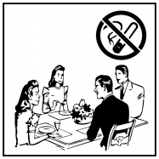
四、看图写话。
1. had better, during
People/They had better not smoke during a/the meal.

Slide 10
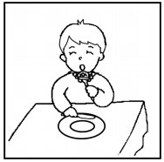
四、看图写话。
2. polite, eat up, plate
It’s polite to eat up all the food on the plate.

Slide 11
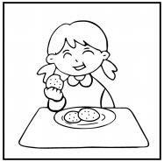
四、看图写话。
3. eat, with， right
The girl/She is eating/eats (the food) with her right hand.

Slide 12
五、熟词生义。
1. add A. vt. 加， 加入
B. vt. 接着说， 又说； 补充说
_____ (1) “They don’t know，” he added.
_____ (2) She added some sugar to her coffee.
B
A

Slide 13
五、熟词生义。
2. order A. vt. & n. 命令 B. n. 点菜
C. vt. & n. 订购 D. n. 秩序
_____ (1) She ordered him back.
_____ (2) May I take your order now?
_____ (3) Some teachers find it difficult to keep order in their classes.
A
B
D

Slide 14
五、熟词生义。
_____ (4) We ordered some face coverings online.
_____ (5) You’d better follow all the orders if you want to work here.
C
A

Slide 15


